Slide 1
“Zhen vis”
Jiefei Xia
Internet of Things Final Project

Slide 2
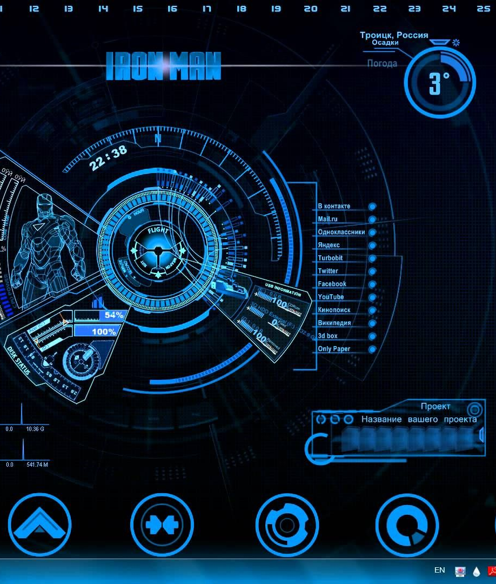
Agenda
User Story Demo
Architecture
Shopping List

Slide 3
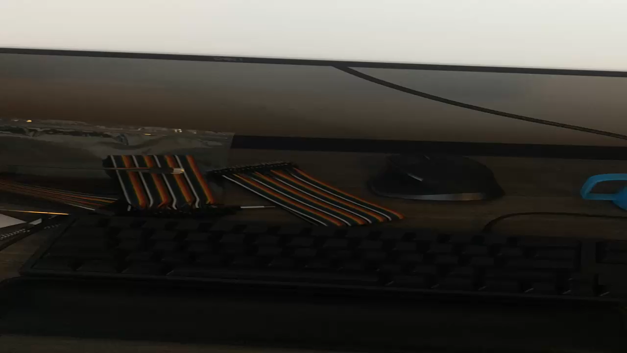
User Story Demo

Slide 4
Architecture v1
Sensor
GPIO
Remote Web Browser
Raspberry Pi
(Web Server)
socketxp
USB Port Control
Water Pump
Problem: Connection Reliability

Slide 5
Architecture v2
Sensor
GPIO
Remote Web Browser
MQTT Server on AWS
Raspberry Pi
Subscribe
publish
USB Port Control
Water Pump
Problem: Scalability

Slide 6
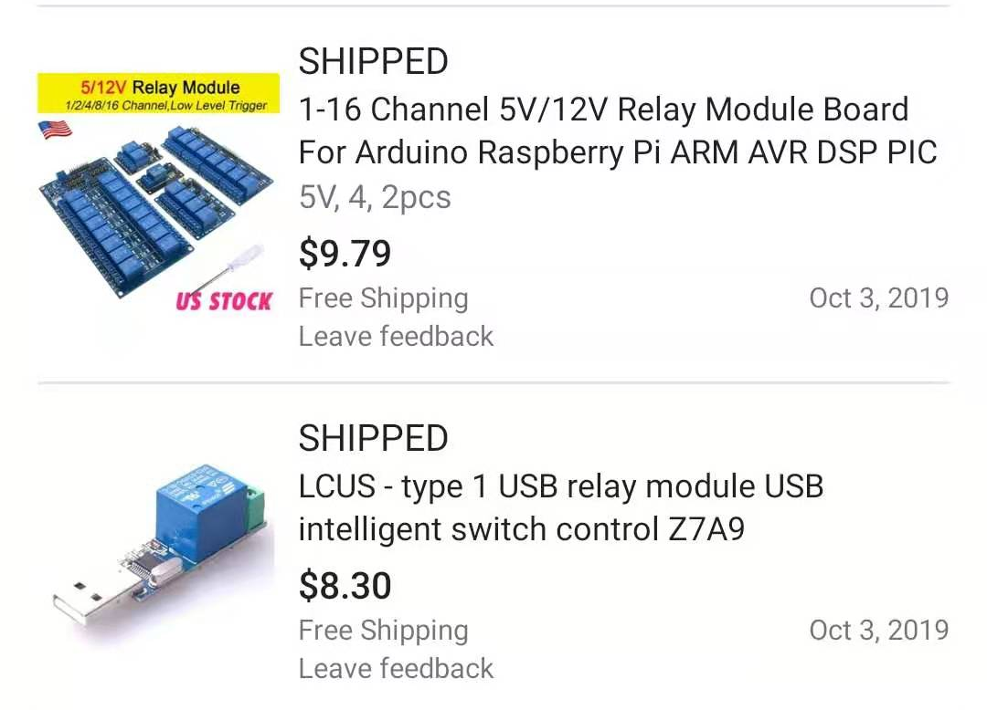
Architecture v3
Sensor
GPIO
Remote Web Browser
MQTT Server on AWS
Raspberry Pi
Subscribe
publish
GPIO
Relay
Switch
Water Pump
Problem: Environmental Friendly
120v Power

Slide 7
Architecture v4
AI water-saving system
Sensor
GPIO
Remote Web Browser
MQTT Server on AWS
Raspberry Pi
Subscribe
publish
GPIO
Relay
Switch
Water Pump
API
OpenWeather
120v Power

Slide 8
Shopping list
Raspberry Pi
Dupont Wire (female-male)
5V Water Pump
Soil Moisture Sensor
USB Relay + USB Charger

